Slide 1
Dimension Reduction
DSCI 5240 Data Mining and Machine Learning for Business
Russell R. Torres
Notes:
Module 3: Dimension Reduction/Introduction to SAS Enterprise Miner
Module Objectives:
Identify the rationale for dimension reduction
Identify the steps of the principal components analysis algorithm
Identify the requirements for principal components analysis
Interpret the results of principal components analysis
Identify the steps of SEMMA and their relationship to SAS Enterprise Miner
Identify the steps of CRISP-DM methodology
Use SAS Enterprise Miner to create a linear regression model

Slide 2
What Variables Should be in the Model?
“I don’t look at a problem and put variables in there that don’t affect it.”
Bill Parcells
Notes:
We often have many more variables (dimensions) represented in our data than we can really effectively manage. In addition to our own limitations, many of the data mining and machine learning approaches we will discuss during this course are not effective for highly dimensional data, due to a phenomenon known as the curse of dimensionality (more on this later). So we are often looking for ways to either selectively remove variables from consideration in our models or to somehow combine variables in order to reduce the dimensions we must account for in our models.

Slide 3
Dimension Reduction

Slide 4
Dimensionality Reduction
Dimensionality reduction is a set of techniques used to reduce the amount of data necessary for prediction while still providing accurate models
Many data mining techniques are not effective for high-dimensional data
Two high level approaches
Feature selection - selectively exclude dimensions from consideration
Feature extraction - mathematically combine dimensions to produce intrinsic/latent dimensions
Airplane Deicing Costs
Snowplow Costs
Heat stroke
Temperature?
Notes:
Reducing the number of dimensions is often necessary. It would not be uncommon for a given organization to have hundreds of variables recorded for important entities such as customers. This is far more than we can handle as humans and often beyond the abilities of the modeling techniques we have at our disposal. We can take two general approaches to reducing dimensionality: feature selection and feature extraction. Feature selection is the process of identifying dimensions and excluding them from consideration. This may be done manually by the modeler (“Hmmm…. I don’t think variable x should really be related to variable y for any reason. I’ll drop it out of my model.”). Alternatively, it may be done using statistical techniques in whatever modeling tool is being used.

Slide 5
Main Approaches
Feature Selection
Manual Feature Selection – The data analyst can examine the available dimensions and exclude those they feel are not useful for modeling purposes
Feature Selection based on Objective Function – A modeling approach is used to identify the features that appear to have the most influence on the dependent variable
Feature Extraction – Maps high dimensional data onto a lower dimensional subspace (i.e., combines variables)
Notes:
Feature selection based on objective function is available in SAS Enterprise Miner using the Variable Selection node. Importantly, this approach doesn’t guarantee you will have the best possible model. It is possible to produce better models with good knowledge of your data and careful consideration of each variable. However, feature selection based on objective function can be a useful starting point should you be faced with a very large number of variables to consider.

Slide 6
The Curse of Dimensionality (Bellman 1961)
The curse of dimensionality is based on the fact that statistical methods count observations that occur in a given space
As dimensions increase
The data needed to make accurate inferences grows exponentially
The observations become sparser (more spread out)
Model performance often suffers as dimensionality increases
Classifier Performance
Dimensionality
Notes:
It is somewhat counterintuitive to think that data mining techniques may not perform as well with a large number of dimensions. You might think that the more data we provide, the better the model that we should be able to produce. This turns out not to be the case because of the nature of dimensional data. As the number of dimensions increase, two things happen. First, for every dimension (column, variable, feature, etc.) we add to the data set, the number of observations (rows) need to draw statistically sound conclusions increases exponentially. That is, moving from having one predictor to two predictors may require the addition of 10-20 observations, but moving from 100 predictors to 101 predictors would require substantially more observations. The second thing that happens is that observations become more sparse in the dimensional space. We sometimes forget to think of the variables in our data as dimensions. If I have one variable, I can plot that variable in one dimension using a number line. If I have two variables, I can plot them in two dimensions using a scatter plot. If I have three variables, I can plot them in three dimensions using a 3D scatter plot. Humans cannot easily visualize beyond 3 dimensions, but this patterns holds no matter how many variables you have. Every time you add a dimension to the data, the data points get spread further and further away from one another. The result is an increase in the complexity for which the model must account. In some cases, the data can become so sparse in dimensional space that a model may either take a tremendous amount of time to find the appropriate solution or it may fail to converge on a solution at all. Model performance roughly follows the graph on the right hand side of this slide. Performance increases sharply as the first several dimensions are added and then falls off precipitously with the addition of more variables.

Slide 7
Goal
Simplify the data by removing unnecessary dimensions (noise)
Improve speed of learning
Improve predictive accuracy
Notes:
The goal of dimensionality reduction approaches is thus to simplify the data, improve the speed with which models operate, and improve the accuracy of the models we produce.

Slide 8
Applications
Dimension reduction is useful anytime there is high-dimension data that may be simplified
Text mining
Image retrieval
Intelligent character recognition
Facial recognition
Dimension reduction is used in the business world when producing models with large datasets
Customers
Products
Etc.

Slide 9
Principal Components Analysis

Slide 10
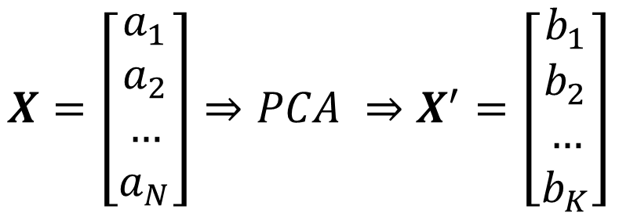

Dimension Reduction and PCA
Principal Components Analysis (PCA) is a feature extraction method which takes a classical linear approach to dimension reduction
PCA projects high-dimensional data onto a lower dimensional sub-space using linear transformation
All dimension reduction techniques involve some degree of information loss
Goal of PCA is to reduce dimensionality while retaining as much information (variation) as possible in the dataset
$$X=\left[\begin{matrix}a_{1} \\ a_{2} \\ … \\ a_{N}\end{matrix}\right]⇒PCA ⇒X^{′}=\left[\begin{matrix}b_{1} \\ b_{2} \\ … \\ b_{K}\end{matrix}\right]$$
$$where K≪N$$
Notes:
If you have not already done so, I encourage you to watch the video where I discuss dimensionality reduction. In that video, I demonstrate that a coffee cup, a three dimensional object, can be represented as a picture of a coffee cup, a two dimensional object. PCA does this same operation by mathematically combining the original variables in a dataset into a new set of variables. The first several of these new variables, called principal components, will contain the majority of the information represented in the original dataset. The last several will contain almost no information and can ultimately be discarded. The equation above suggests that you start with some dataset X which consists of dimensions a1-aN. After performing PCA, you get a new dataset X’ which consists of new dimensions (completely different variables which are some linear combination of the original variables), b1-bK. If done correctly you will have far fewer b predictors than you had a predictors when you began.

Slide 11
PCA Requirements
PCA, when used for dimension reduction, only involves predictors
PCA can only be performed on dimensions which are at least interval in nature

Slide 12

Notes:
Before we get into the details, please know that I recognize that some of this math may be new to you. I have tried to give you several slides on background linear algebra concepts. Please consider these slides carefully and try to think through how they are being applied in the PCA algorithm. This may take some time to wrap your head around… that’s okay! Feel free to ask questions of your classmates or myself.

Slide 13


Some Matrix Terminology
Matrix: a rectangular array of rows and columns
If the number of rows is equal to the number of columns, the matrix is square
Principal: Diagonal from upper-left to lower right of a matrix
Principal elements: Elements of the principal
Trace: Sum of the principal elements
Principal (Diagonal)
$$\left[\begin{matrix}5 & 2 & 4 \\ −3 & 6 & 2 \\ 3 & −3 & 1\end{matrix}\right]$$
$$trace=\left(5+6+1\right)=12$$
Notes:
PCA requires linear algebra, specifically matrix math operations. The following few slides are simply a refresher on what matrices are and how various mathematical operations work on matrices.

Slide 14
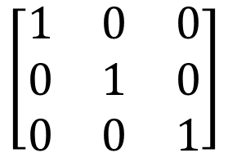
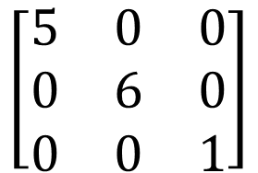
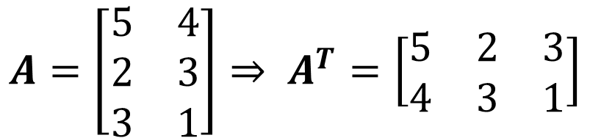
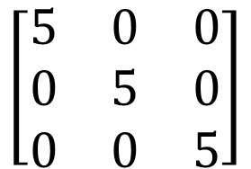
More Matrix Terminology
Diagonal matrix: Matrix in which all non-diagonal elements are zero
Identity/Unity matrix: Scalar matrix in which all diagonal elements equal 1
$$\left[\begin{matrix}5 & 0 & 0 \\ 0 & 6 & 0 \\ 0 & 0 & 1\end{matrix}\right]$$
$$\left[\begin{matrix}1 & 0 & 0 \\ 0 & 1 & 0 \\ 0 & 0 & 1\end{matrix}\right]$$
Scalar matrix: Diagonal matrix in which all diagonal elements are equal
Transpose matrix A^{T} of matrix A obtained by converting rows to columns and columns to rows
$$\left[\begin{matrix}5 & 0 & 0 \\ 0 & 5 & 0 \\ 0 & 0 & 5\end{matrix}\right]$$
$$A=\left[\begin{matrix}5 & 4 \\ 2 & 3 \\ 3 & 1\end{matrix}\right]⇒ A^{T}=\left[\begin{matrix}5 & 2 & 3 \\ 4 & 3 & 1\end{matrix}\right]$$

Slide 15
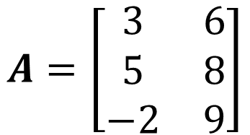
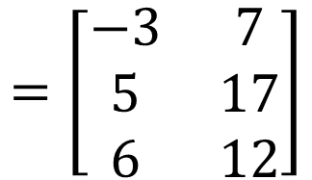
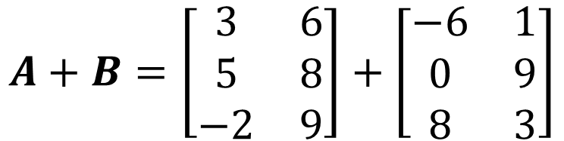

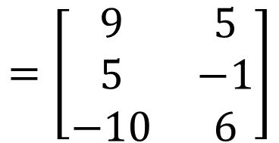
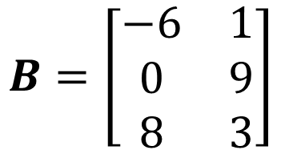
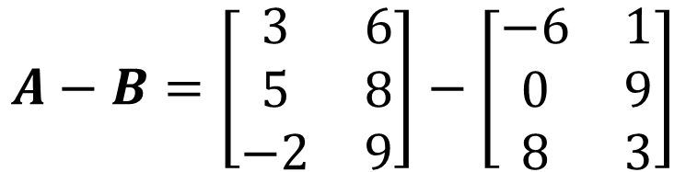
Matrix Operations
$$A=\left[\begin{matrix}3 & 6 \\ 5 & 8 \\ −2 & 9\end{matrix}\right]$$
$$B=\left[\begin{matrix}−6 & 1 \\ 0 & 9 \\ 8 & 3\end{matrix}\right]$$
Addition:
Subtraction:
$$Z=A+B⟺z_{i,j}=a_{i,j}+b_{i,j}$$
$$Z=A−B⟺z_{i,j}=a_{i,j}−b_{i,j}$$
$$A+B=\left[\begin{matrix}3 & 6 \\ 5 & 8 \\ −2 & 9\end{matrix}\right]+\left[\begin{matrix}−6 & 1 \\ 0 & 9 \\ 8 & 3\end{matrix}\right]$$
$$A−B=\left[\begin{matrix}3 & 6 \\ 5 & 8 \\ −2 & 9\end{matrix}\right]−\left[\begin{matrix}−6 & 1 \\ 0 & 9 \\ 8 & 3\end{matrix}\right]$$
$$=\left[\begin{matrix}−3 & 7 \\ 5 & 17 \\ 6 & 12\end{matrix}\right]$$
$$=\left[\begin{matrix}9 & 5 \\ 5 & −1 \\ −10 & 6\end{matrix}\right]$$
Notes:
We generally represent matrices using bold, capital letters.
Addition and subtraction of matrices is only defined if the matrices involved have exactly the same number of rows and columns. If that is the case, the resulting matrix will also have the same number of rows and columns. The solution is derived by adding (or subtracting) each position in the original matrices.

Slide 16


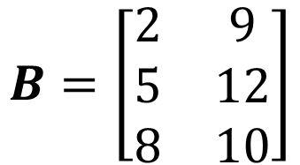

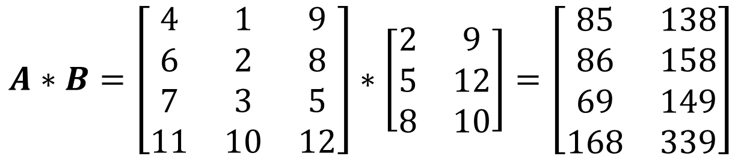

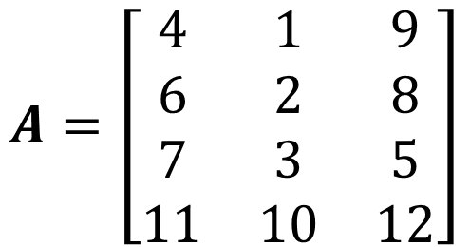




Matrix Operations
Multiplication: $Z=A∗B$ defined if number of columns in $A$ equals the number of rows in $B$
$$Z=A∗B ⟺z_{i,j}=a_{i,1}∗b_{1,j}+a_{i,2}∗b_{2,j}+a_{i,3}∗b_{3,j}+…a_{i,m}∗b_{n,j}$$
$$A=\left[\begin{matrix}4 & 1 & 9 \\ 6 & 2 & 8 \\ 7 & 3 & 5 \\ 11 & 10 & 12\end{matrix}\right]$$
$$B=\left[\begin{matrix}2 & 9 \\ 5 & 12 \\ 8 & 10\end{matrix}\right]$$
$$A∗B=\left[\begin{matrix}4 & 1 & 9 \\ 6 & 2 & 8 \\ 7 & 3 & 5 \\ 11 & 10 & 12\end{matrix}\right]∗\left[\begin{matrix}2 & 9 \\ 5 & 12 \\ 8 & 10\end{matrix}\right]=\left[\begin{matrix}85 & 138 \\ 86 & 158 \\ 69 & 149 \\ 168 & 339\end{matrix}\right]$$
$$(4∗2$$
$$+ 1∗5$$
$$+ 9∗8)$$
$$=85$$
$$(4∗9$$
$$+ 1∗12$$
$$+ 9∗10)$$
$$=138$$
Notes:
Multiplication is a bit more complicated but fairly straightforward once you figure out the pattern. To multiply two matrices (A and B), the number of columns in one matrix (A) must match the number of rows in the other matrix (B). The resulting matrix (Z) will have the same number of rows as A and the same number of columns as B. The solution is derived by multiplying the row elements of A by the column elements of B.

Slide 17

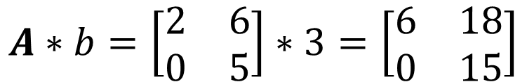


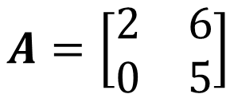


Matrix Operations
Multiplication: $Z=A∗b$ where $b$ is a scalar
$$Z=A∗b ⟺z_{ij}=a_{i1}∗b+a_{i2}∗b+…a_{im}∗b$$
$$A=\left[\begin{matrix}2 & 6 \\ 0 & 5\end{matrix}\right]$$
$$b=3$$
$$A∗b=\left[\begin{matrix}2 & 6 \\ 0 & 5\end{matrix}\right]∗3=\left[\begin{matrix}6 & 18 \\ 0 & 15\end{matrix}\right]$$
$$2∗3=6$$
$$6∗3=18$$
$$0∗3=0$$
$$5∗3=15$$
Notes:
It is also possible to multiply a matrix by a scalar value. A scalar value is just a single, ordinary number. To multiply a matrix A by a scalar b, you simply multiply every element in A by b. The resulting matrix will have the same number of rows and columns as A.

Slide 18
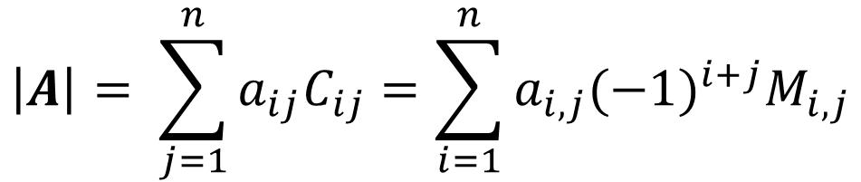

Determinant
Determinant: A function that associates a scalar to a square matrix
Singularity
A matrix with a nonzero determinant is called non-singular (it has an inverse)
Conversely, a matrix with a zero determinant is called singular (it has no inverse)
The determinant of matrix A is denoted |A| or det(A)
Laplace’s Formula
$$\left|A\right|= \sum_{j=1}^{n}{a_{ij}C_{ij}}=\sum_{i=1}^{n}{a_{i,j}{(−1)}^{i+j}M_{i,j}}$$
Where
$M_{ij}$: the i, j minor matrix of $A$. Obtained by removing row i and column j
$C_{ij}$: the scalar cofactor of $A$
Notes:
I won’t trouble you with the exact details of what a determinant is… suffice it to say that we need to be able to calculate them to perform PCA. If you are interested in the details, you might check out https://www.youtube.com/watch?v=vvR3JSXO2fo. One of the more important properties of the determinant is that it can tell us whether the matrix is singular or not. Singular matrices can be problematic, as some mathematical operations cannot be performed on a singular matrix. PCA, for instance, requires that a matrix be non-singular. To calculate the determinant of a matrix, we use Laplace’s formula. Like many other formulas used in matrix operations, it looks scary but is pretty simple once you figure out the pattern.

Slide 19

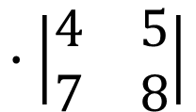
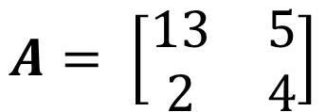



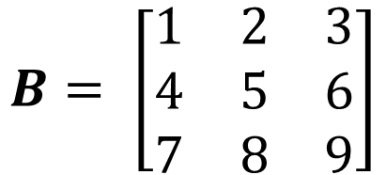
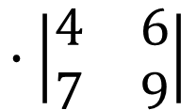



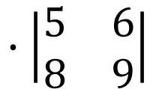

Determinant Example
2 x 2 Matrix
3 x 3 Matrix
$$A= \left[\begin{matrix}13 & 5 \\ 2 & 4\end{matrix}\right]$$
$$B= \left[\begin{matrix}1 & 2 & 3 \\ 4 & 5 & 6 \\ 7 & 8 & 9\end{matrix}\right]$$
$$∙\left|\begin{matrix}5 & 6 \\ 8 & 9\end{matrix}\right|$$
$$∙\left|\begin{matrix}4 & 6 \\ 7 & 9\end{matrix}\right|$$
$$∙\left|\begin{matrix}4 & 5 \\ 7 & 8\end{matrix}\right|$$
$$\left|A\right|=a_{1,1}a_{2,2}−a_{1,2}a_{2,1}$$
$$\left|B\right|=$$
$$1$$
$$−2$$
$$+3$$
$$\left|B\right|=1∙\left(\left(5∗9\right)−(8∗6)\right)$$
$$−2∙\left(\left(4∗9\right)−(7∗6)\right)$$
$$\left|A\right|=\left(13\right)\left(4\right)−\left(5\right)\left(2\right)=42$$
$$3∙\left(\left(4∗8\right)−\left(7∗5\right)\right)=0$$
Notes:
Finding the determinant is based on a pattern.
For a 2x2 matrix, the determinant is equal to the difference between the products of the diagonals. Starting from the upper left to lower right, you multiply the values and then subtract the product of the lower left to upper right.
For a 3x3 matrix, the solution is a bit more complicated. You can use the method of minors, where you pull out a scalar value from the matrix and multiply it by the remaining 2x2 matrix. For a detailed walk-through of finding the determinant of 2x2 and 3x3 matrices, check out https://www.youtube.com/watch?v=fItksxO6RZw.

Slide 20
PCA Methodology
Step 1: Calculate the mean of each dimension
Step 2: Calculate the variance/covariance matrix
Calculate the variance of each attribute
Calculate the covariance of the attributes
Construct the matrix
Step 3: Compute the Eigenvalues of the covariance matrix and order them from largest to smallest
Step 4: Compute the Eigenvectors of the covariance matrix for the associated with the Eigenvalues
Step 5: Keep terms corresponding to the K largest Eigenvalues
Notes:
With that background out of the way, we can now begin to talk about PCA. In step 1, we simply calculate the average values of each variable. Steps 2-4 are why we spent so much time talking about matrix operations. Lets walk though a simple example.

Slide 21
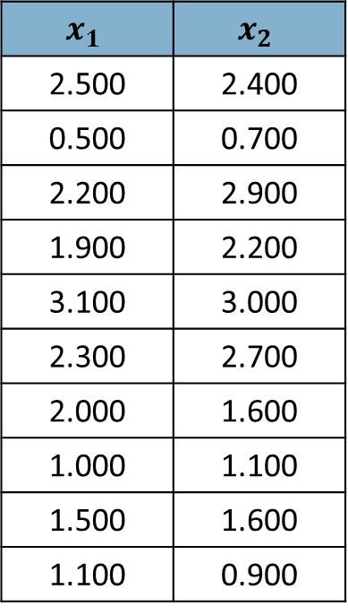
Example Data
$$x_{1}$$ | $$x_{2}$$
2.500 | 2.400
0.500 | 0.700
2.200 | 2.900
1.900 | 2.200
3.100 | 3.000
2.300 | 2.700
2.000 | 1.600
1.000 | 1.100
1.500 | 1.600
1.100 | 0.900
Notes:
In this example we have two predictor variables. Notice that we do not have our dependent variable in this table. If we plot x1 against x2 you can see a 2 dimensional representation of this data. In the context of PCA, “information” and “variation” mean exactly the same thing. So if I were to ask, which dimension contains the most information, you would have to examine x1 and x2 and determine which variable had more variation. In this example they are quite close. You can see that visually by looking at the scatter plot and noticing that the points range from about 0.5 to 3 on both axes. In reality, the path through the data that has the most variation isn’t along the x1 or x2 axes. It is a diagonal that runs from the lower left to the upper right through the data. The next longest path through the data is orthogonal to that path.
Recall the coffee cup example. Find the longest path through the object… i.e., the path with the most variation and thus represents the most information. Then rotate around that axis until you find the next longest path through the object. We are doing the exact same thing here with our data.
PCA is all about finding these paths through the data (Eigenvectors) and determining how much variation/information (Eigenvalues) is associated with them.

Slide 22
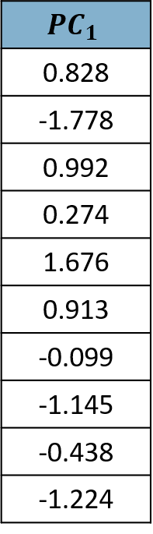
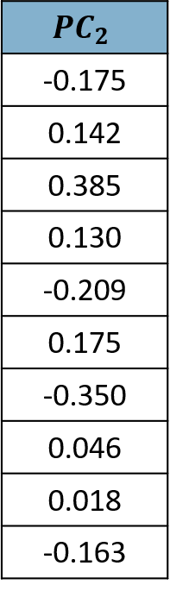
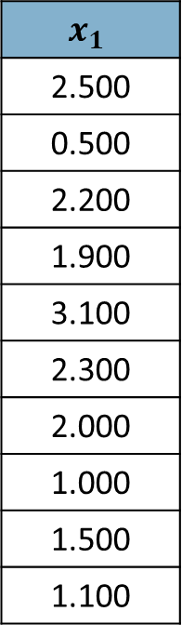
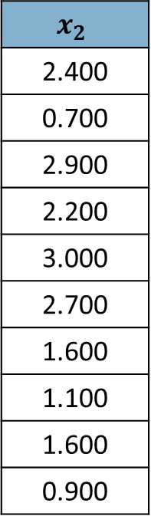
Example Data
$$x_{1}$$
2.500
0.500
2.200
1.900
3.100
2.300
2.000
1.000
1.500
1.100
$$x_{2}$$
2.400
0.700
2.900
2.200
3.000
2.700
1.600
1.100
1.600
0.900
Notes:
PCA will take our original variables x1 and x2 and “mathemagically” mix them up (create linear combinations). Those resulting combinations will be called principal components, pc1 and pc2. PCA will always generate the same number of components as you had original variables. We will then examine the principal components and discard those that don’t provide much information…. Resulting in dimensionality reduction.
This is a very simplified example. We are starting with two dimensions and it doesn’t take a rocket scientist to determine that we will ultimately get rid of one of our principal components. We can’t get rid of both or we wouldn’t have any information at all!

Slide 23
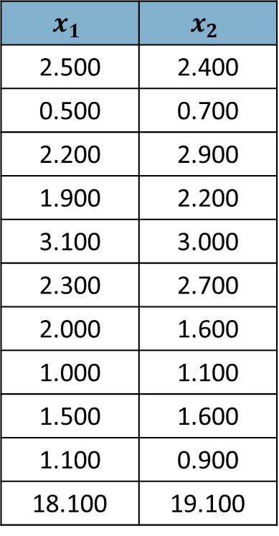
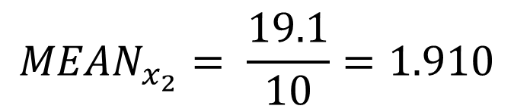
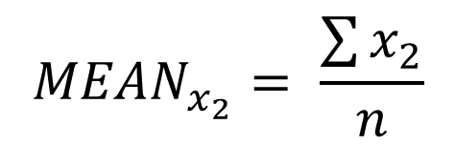
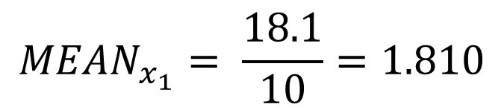
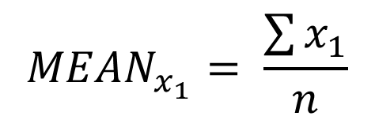
Step 1: Calculate Means
$$x_{1}$$ | $$x_{2}$$
2.500 | 2.400
0.500 | 0.700
2.200 | 2.900
1.900 | 2.200
3.100 | 3.000
2.300 | 2.700
2.000 | 1.600
1.000 | 1.100
1.500 | 1.600
1.100 | 0.900
18.100 | 19.100
$${MEAN}_{x_{1}}= \frac{\sum{x_{1}}}{n}$$
$${MEAN}_{x_{1}}= \frac{18.1}{10}=1.810$$
$${MEAN}_{x_{2}}= \frac{\sum{x_{2}}}{n}$$
$${MEAN}_{x_{2}}= \frac{19.1}{10}=1.910$$
Sum:
Notes:
In step 1, we calculate the means of both variables.

Slide 24
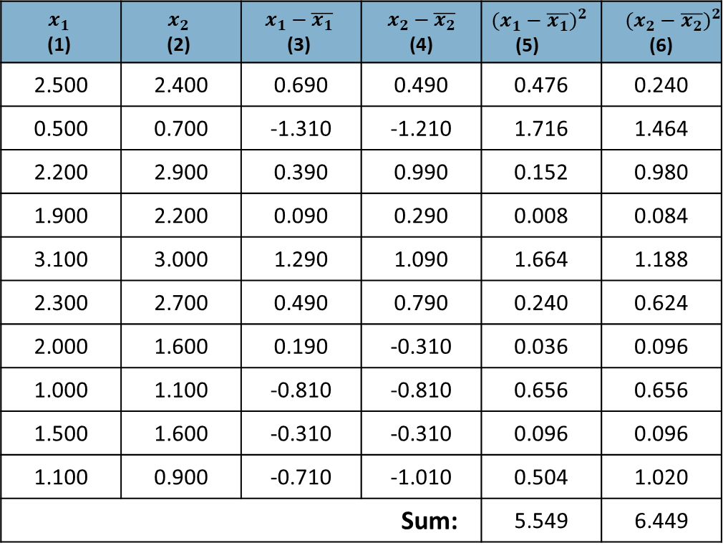
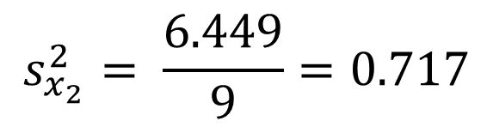
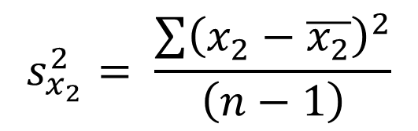
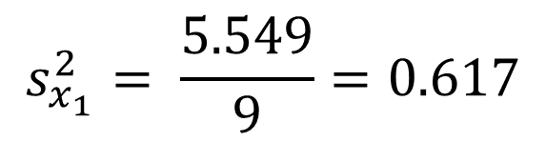
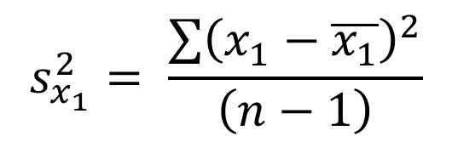
Step 2a: Calculate Variances
$$x_{1}$$ (1) | $$x_{2}$$ (2) | $$x_{1}−\overline{x_{1}}$$ (3) | $$x_{2}−\overline{x_{2}}$$ (4) | $${(x_{1}−\overline{x_{1}})}^{2}$$ (5) | $${(x_{2}−\overline{x_{2}})}^{2}$$ (6)
2.500 | 2.400 | 0.690 | 0.490 | 0.476 | 0.240
0.500 | 0.700 | -1.310 | -1.210 | 1.716 | 1.464
2.200 | 2.900 | 0.390 | 0.990 | 0.152 | 0.980
1.900 | 2.200 | 0.090 | 0.290 | 0.008 | 0.084
3.100 | 3.000 | 1.290 | 1.090 | 1.664 | 1.188
2.300 | 2.700 | 0.490 | 0.790 | 0.240 | 0.624
2.000 | 1.600 | 0.190 | -0.310 | 0.036 | 0.096
1.000 | 1.100 | -0.810 | -0.810 | 0.656 | 0.656
1.500 | 1.600 | -0.310 | -0.310 | 0.096 | 0.096
1.100 | 0.900 | -0.710 | -1.010 | 0.504 | 1.020
Sum: |  |  |  | 5.549 | 6.449
$$s_{x_{1}}^{2}= \frac{\sum{{\left(x_{1}−\overline{x_{1}}\right)}^{2}}}{\left(n−1\right)}$$
$$s_{x_{1}}^{2}= \frac{5.549}{9}=0.617$$
$$s_{x_{2}}^{2}= \frac{\sum{{\left(x_{2}−\overline{x_{2}}\right)}^{2}}}{\left(n−1\right)}$$
$$s_{x_{2}}^{2}= \frac{6.449}{9}=0.717$$
Notes:
In step 2, we begin by calculating the variance of each dimension. Columns 1 and 2 are our original dimensions. Column 3 is x1 minus its mean, and column 4 is x2 minus its mean. Columns 5 and 6 are the squares of columns 3 and 4 respectively. To calculate variance, we sum columns 5 and 6 and then divide by the number of observations minus 1.
Variance is a measure of how spread out the data are from the mean. You may be more familiar with standard deviation as a measure of spread. Standard deviation is equal to the square root of variance. Both measure essentially the same thing.

Slide 25
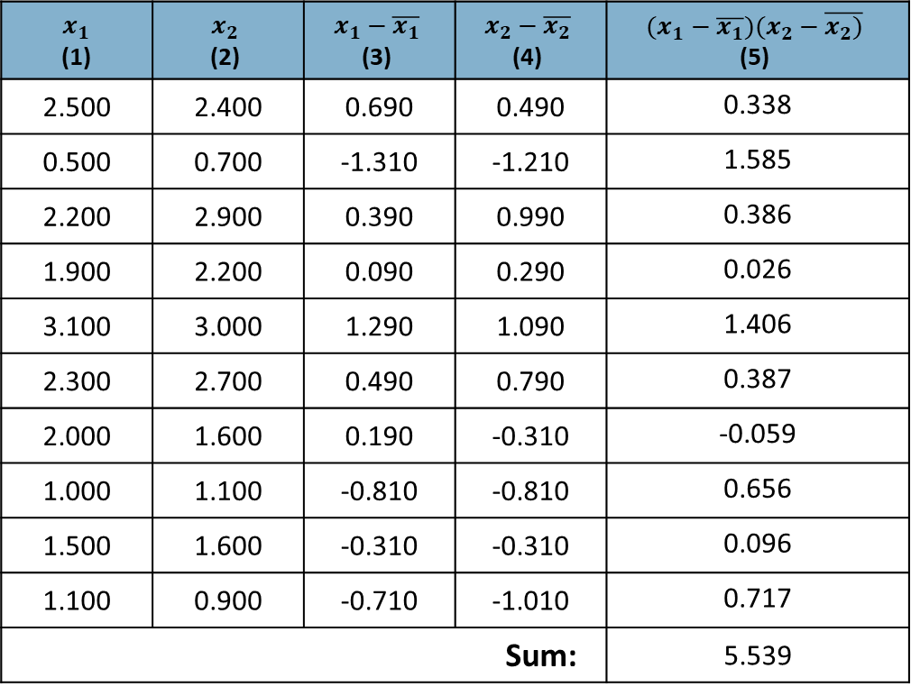
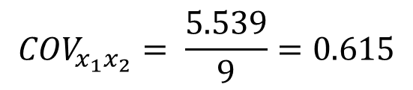
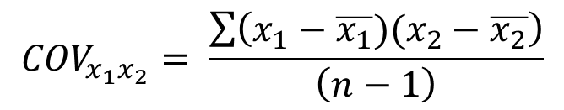
Step 2b: Calculate Covariance
$$x_{1}$$ (1) | $$x_{2}$$ (2) | $$x_{1}−\overline{x_{1}}$$ (3) | $$x_{2}−\overline{x_{2}}$$ (4) | $$(x_{1}−\overline{x_{1}})(x_{2}−\overline{x_{2})}$$ (5)
2.500 | 2.400 | 0.690 | 0.490 | 0.338
0.500 | 0.700 | -1.310 | -1.210 | 1.585
2.200 | 2.900 | 0.390 | 0.990 | 0.386
1.900 | 2.200 | 0.090 | 0.290 | 0.026
3.100 | 3.000 | 1.290 | 1.090 | 1.406
2.300 | 2.700 | 0.490 | 0.790 | 0.387
2.000 | 1.600 | 0.190 | -0.310 | -0.059
1.000 | 1.100 | -0.810 | -0.810 | 0.656
1.500 | 1.600 | -0.310 | -0.310 | 0.096
1.100 | 0.900 | -0.710 | -1.010 | 0.717
Sum: |  |  |  | 5.539
$${COV}_{x_{1}x_{2}}= \frac{\sum{\left(x_{1}−\overline{x_{1}})(x_{2}−\overline{x_{2}}\right)}}{\left(n−1\right)}$$
$${COV}_{x_{1}x_{2}}= \frac{5.539}{9}=0.615$$
Notes:
Next, we need to measure covariance. Covariance is a measure of how much two variables vary together. That is, it is a measure of the strength of the correlation between two variables. Beginning with our x1 and x2 values in columns 1 and 2, we subtract off the means in columns 3 and 4 as we did before. Column 5 is the product of columns 3 and 4. Summing column 5 and dividing by the number of observations minus one give us the covariance between x1 and x2.

Slide 26
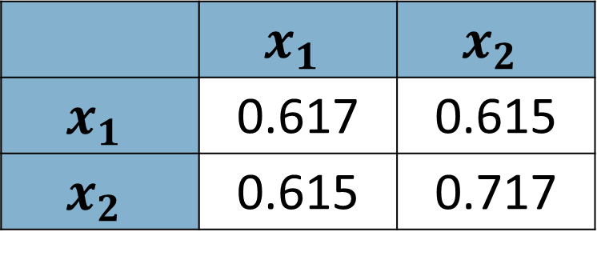
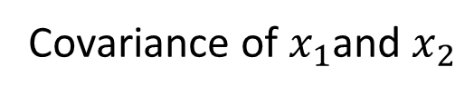
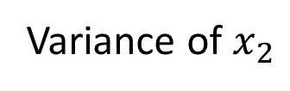
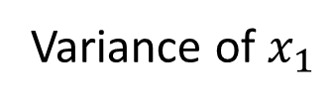
Step 2c: Construct Variance/Covariance Matrix
Variance of $x_{1}$
 | $$x_{1}$$ | $$x_{2}$$
$$x_{1}$$ | 0.617 | 0.615
$$x_{2}$$ | 0.615 | 0.717
Variance of $x_{2}$
Covariance of $x_{1}$and $x_{2}$
Notes:
Finally, we have all of the information needed to create a variance/covariance matrix. It is this matrix that will be used to find the paths through the data (Eigenvectors) and the variance along those paths (Eigenvalues). We start with Eigenvalues first.

Slide 27
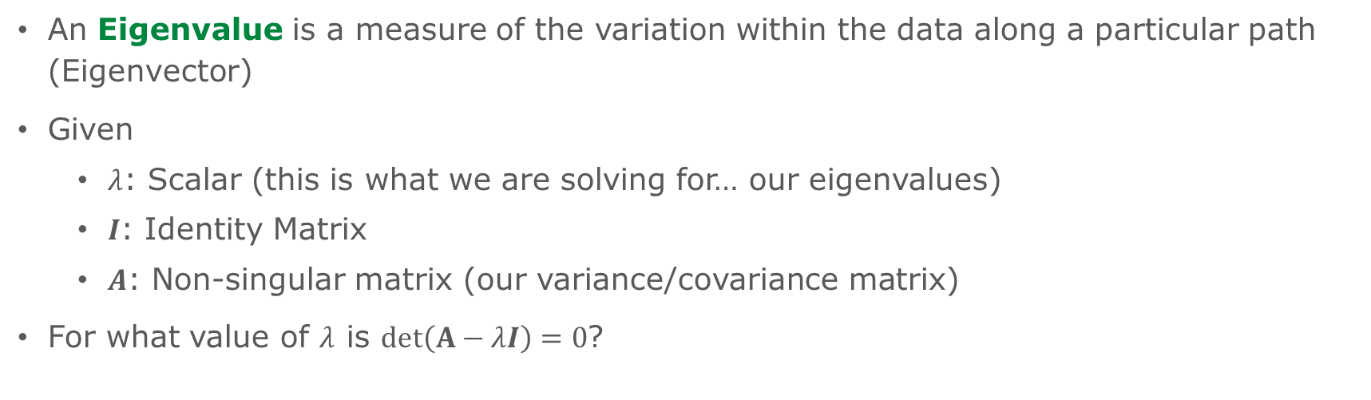
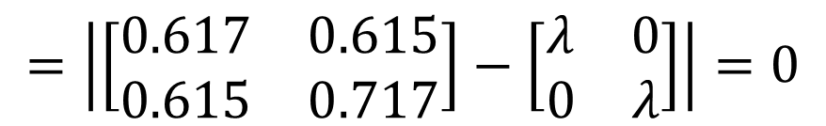
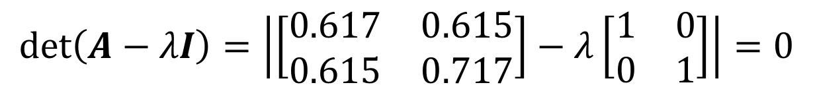
Step 3: Compute Eigenvalues
An Eigenvalue is a measure of the variation within the data along a particular path (Eigenvector)
Given
$λ$: Scalar (this is what we are solving for… our eigenvalues)
$I$: Identity Matrix
$A$: Non-singular matrix (our variance/covariance matrix)
For what value of $λ$ is $det\left(A−λI\right)=0$?
$$\det\left(A−λI\right)=\left|\left[\begin{matrix}0.617 & 0.615 \\ 0.615 & 0.717\end{matrix}\right]−λ\left[\begin{matrix}1 & 0 \\ 0 & 1\end{matrix}\right]\right|=0$$
{1}
$$=\left|\left[\begin{matrix}0.617 & 0.615 \\ 0.615 & 0.717\end{matrix}\right]−\left[\begin{matrix}λ & 0 \\ 0 & λ\end{matrix}\right]\right|=0$$
{2}
Notes:
{1} we set up the equation. When is the determinant of our variance/covariance matrix minus lambda times the identity matrix equal to zero.
{2} recall that we can multiply a matrix by a scalar value by multiplying every element in the matrix by the scalar. In this case, because our scalar lambda is being multiplied by the identity matrix which has ones on the diagonal and zeros off diagonal, we are left with a matrix with lambda on the diagonal and zeros off diagonal.

Slide 28
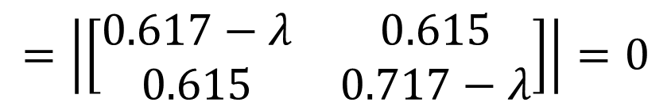

Step 3: Compute Eigenvalues
$$=\left|\left[\begin{matrix}0.617−λ & 0.615 \\ 0.615 & 0.717−λ\end{matrix}\right]\right|=0$$
{1}
F
L
{2}
$$=\left(0.617−λ\right)\left(0.717−λ\right)−{0.615}^{2}=0$$
Characteristic Equation
I
O
{3}
$$=\left(0.442\right)−\left(0.617λ\right)−\left(0.717λ\right)+λ^{2}−{0.615}^{2}=0$$
F
O
I
L
{4}
$$=λ^{2}−1.333λ+0.063=0$$
Notes:
{1} we can further simplify the equation by subtracting the two matrices since they have the same number of rows and columns. We need to find the determinant of the resulting 2x2 matrix.
{2} we find the determinant of a 2x2 matrix by findings the difference of the diagonal products. We multiply 0.617-lambda by 0.717-lambda and then subtract 0.615 times 0.615. You may recall the FOIL method from elementary algebra which is mnemonic that describes how to multiply two binomials. As a reminder, FOIL stands for First, Outside, Inside, Last.
{3} shows the result of the binomial multiplication
{4) is the simplified equation. You may recognize this as a quadratic equation. Recall that we started out with two dimensions and consider that quadratic equations always have two solutions. This is not an accident. Two original dimensions will result in two eigenvalues. Had we begun with 1000 original dimensions, we would have an equation with 1000 solutions.

Slide 29







Step 3: Compute Eigenvalues
{1}
$$={1λ}^{2}−1.333λ+0.063=0$$
$$a=1$$
$$\frac{−b±\sqrt{b^{2}−4ac}}{2a}=0$$
{2}
$$b=−1.333$$
$$c=0.063$$
$$λ_{1}=\frac{−\left(−1.333\right)+\sqrt{{(−1.333)}^{2}−4(1)(0.063)}}{2(1)}=1.284$$
{3}
$$λ_{2}=\frac{−\left(−1.333\right)−\sqrt{{(−1.333)}^{2}−4(1)(0.063)}}{2(1)}=0.050$$
{4}
Notes:
{1} is our simplified equation carried forward from the last slide.
{2} you may recall the quadratic formula from algebra that allows us to easily solve equations like {1}
{3} and {4} are the solutions and lambda 1 and lambda 2 are the eigenvalues associated with our variance/covariance matrix. Remember that an eigenvalue is a measure of variation/information. Based on these eigenvalues, we can already see that one of our eigenvectors (which we will find in subsequent steps) is associated with a lot of information and one is associated with very little information.

Slide 30



Observation
$$A=\left[\begin{matrix}0.617 & 0.615 \\ 0.615 & 0.717\end{matrix}\right]$$
$$trace\left(A\right)=\left(0.617+0.717\right)=1.334$$
$${(λ}_{1}+λ_{2})=\left(1.284+0.050\right)=1.334$$
You can write Eigenvalues as a percentage of trace(A)
$$\frac{λ_{1}}{trace(A)}∗100=\frac{1.284}{1.334}∗100=96.25\%$$
$$\frac{λ_{2}}{trace(A)}∗100=\frac{0.050}{1.334}∗100=3.75\%$$
The largest Eigenvalue ($λ_{1}$) is referred to as the principal Eigenvalue
Notes:
This observation is nice because it allows us to compare eigenvalues and understand their contribution to the total information contained in the data. Eigenvalue 1 (lambda 1) captures 96% of the information contained in the original two variables. Eigenvalue 2 (lambda 2) only accounts for about 4%. This helps us determine which principal components we will keep and which we will throw away.

Slide 31

Another Observation
The product of the Eigenvalues is the determinant of the matrix
$$A=\left[\begin{matrix}0.617 & 0.615 \\ 0.615 & 0.717\end{matrix}\right]$$
$$det\left(A\right)=\left(0.617∗0.717\right)−(0.615∗0.615)=0.064$$
$${(λ}_{1}∗λ_{2})=\left(1.284∗0.050\right)=0.064$$
Notes:
This is another useful observation for checking that you have correctly determined the eigenvalues associated with a given matrix.

Slide 32




Step 4: Calculate Eigenvectors
An Eigenvector is the magnitude and direction of a path through the data
For each Eigenvalue $λ_{i}$, there is a set of associated Eigenvectors
The number of Eigenvectors in the set is infinite
Eigenvectors corresponding to different Eigenvalues are linearly independent
Given $λ_{i}$, find a vector $\vec{Z}$such that $\left(A−λ_{i}I\right)\vec{Z}=0$
{1}
$$\left(\left[\begin{matrix}0.617 & 0.615 \\ 0.615 & 0.717\end{matrix}\right]−λ_{i}\left[\begin{matrix}1 & 0 \\ 0 & 1\end{matrix}\right]\right)\vec{Z}=0$$
{2}
$$\left(\left[\begin{matrix}0.617 & 0.615 \\ 0.615 & 0.717\end{matrix}\right]−\left[\begin{matrix}λ_{i} & 0 \\ 0 & λ_{i}\end{matrix}\right]\right)\vec{Z}=0$$
{3}
$$\left(\left[\begin{matrix}0.617−λ_{i} & 0.615 \\ 0.615 & 0.717−λ_{i}\end{matrix}\right]\right)\vec{Z}=0$$
Notes:
To recap, at this point we have taken our two variables x1 and x2, created a variance/covariance matrix, and used that matrix to identify eigenvectors (the variance associated with the two longest paths through the data). Now we need to identify the Eigenvectors associated with the matrix, the paths for which we just calculated variance. To do so, we set up an equation in which we subtract each eigenvalue times the identity matrix from our variance/covariance matrix. We then multiply this value by a vector Z such that it equals zero. For our purposes, a vector is just a matrix with one column.
{1} substitutes our variance/covariance matrix for A
{2} multiplies the identity matrix by the scalar lambda sub i
{3} subtracts the diagonal lambda matrix from the variance covariance matrix
Now, we can substitute each eigenvalue (lambda) and solve for the vector Z

Slide 33






Step 4: Calculate Eigenvectors
Consider $λ_{1}=1.284$
{1}
$$\left(\left[\begin{matrix}0.617−1.284 & 0.615 \\ 0.615 & 0.717−1.284\end{matrix}\right]\right)\vec{Z}=0$$
{2}
$$=\left(\left[\begin{matrix}−0.667 & 0.615 \\ 0.615 & −0.567\end{matrix}\right]\right)\left[\begin{matrix}z_{1} \\ z_{2}\end{matrix}\right]=\left[\begin{matrix}0 \\ 0\end{matrix}\right]$$
{3}
$$−0.667z_{1}+0.615z_{2}=0$$
{4}
$$0.615z_{1}+(−0.567)z_{2}=0$$
$$z_{1}$$ | 0.922 | 1.844 | 2.766 | …
$$z_{2}$$ | 1 | 2 | 3 | …
{5}
$$z_{1}=0.922z_{2}$$
Notes:
{1} substitute the value of our first eigenvalue
{2} simplify and represent Z and 0 as single column matrices (vectors)
{3} and {4} are two equations created by multiplying the two matrices and setting the value equal to zero. These appear to be different, but they are essentially the same… meaning we can’t really solve one for a variable and substitute it into the other. Instead, we choose one and simplify as much as possible. I chose {3} and simplified it to the equation represented in {5}.
At this point we have one equation with two variables and we can solve this equation by choosing values of z2 and calculating the associated values of z1. This is why we say that there is an infinite set of eigenvectors associated with each eigenvalue. We will find a way to simplify this set of eigenvectors into a single representation shortly.

Slide 34






Step 4: Calculate Eigenvectors
Consider $λ_{2}=0.050$
{1}
$$\left(\left[\begin{matrix}0.617−0.050 & 0.615 \\ 0.615 & 0.717−0.050\end{matrix}\right]\right)\vec{Z}=0$$
{2}
$$=\left(\left[\begin{matrix}0.567 & 0.615 \\ 0.615 & 0.667\end{matrix}\right]\right)\left[\begin{matrix}z_{1} \\ z_{2}\end{matrix}\right]=\left[\begin{matrix}0 \\ 0\end{matrix}\right]$$
{3}
$$0.567z_{1}+0.615z_{2}=0$$
{4}
$$0.615z_{1}+0.667z_{2}=0$$
$$z_{1}$$ | -1.085 | -2.170 | -3.255 | …
$$z_{2}$$ | 1 | 2 | 3 | …
{5}
$$−z_{1}=0.922z_{2}$$
Notes:
{1} substitute the value of our second eigenvalue
{2} simplify and represent Z and 0 as single column matrices (vectors)
{3} and {4} are two equations created by multiplying the two matrices and setting the value equal to zero. These appear to be different, but they are essentially the same… meaning we can’t really solve one for a variable and substitute it into the other. Instead, we choose one and simplify as much as possible. I chose {3} and simplified it to the equation represented in {5}.
As before, we can choose values of z2 and find the associated values of z1.

Slide 35









Normalizing Eigenvectors
Dealing with infinite sets is difficult
Statistical packages typically normalize Eigenvectors
$$[z_{1s},z_{2s}]=\frac{[z_{1}, z_{2}]}{\sqrt{z_{1}^{2}+z_{2}^{2}}}$$
{1}
$$z_{1s}=\frac{z_{1}}{\sqrt{z_{1}^{2}+z_{2}^{2}}}=\frac{0.922}{\sqrt{{0.922}^{2}+1^{2}}}=0.678$$
$$z_{1}$$ | 0.922 | 1.844 | 2.766 | …
$$z_{2}$$ | 1 | 2 | 3 | …
$$λ_{1}$$
$$z_{2s}=\frac{z_{2}}{\sqrt{z_{1}^{2}+z_{2}^{2}}}=\frac{1}{\sqrt{{0.922}^{2}+1^{2}}}=0.735$$
{1}
$$z_{1s}=\frac{z_{1}}{\sqrt{z_{1}^{2}+z_{2}^{2}}}=\frac{−1.085}{\sqrt{{−1.085}^{2}+1^{2}}}=−0.735$$
$$z_{1}$$ | -1.085 | -2.170 | -3.255 | …
$$z_{2}$$ | 1 | 2 | 3 | …
$$λ_{2}$$
$$z_{2s}=\frac{x_{2}}{\sqrt{z_{1}^{2}+z_{2}^{2}}}=\frac{1}{\sqrt{{−1.085}^{2}+1^{2}}}=0.678$$
Notes:
We have now calculated the eigenvalues associated with our matrix and determined the corresponding infinite sets of eigenvectors. Infinite sets are difficult to work with and we commonly normalize them so that they can be represented as a single set of numbers. To normalize the values we divide each eigenvector element (z) by the square root of the sum of the squared elements of the eigenvector. We can choose any pair of corresponding z1 and z2 values… you will get the same answer no matter which set you select. In this case, I chose the values represented in column {1} for each eigenvalue.

Slide 36
Eigenvalues and Eigenvectors
For our example:
Component | Eigenvalue | Normalized Eigenvectors
PC1 | 1.284 | z1=0.678 | z2=0.735
PC2 | 0.050 | z1=-0.735 | z2=0.678
It is clear that PC1 is associated with significantly more variation than PC2
Discarding PC2 allows us to reduce dimensions (2 → 1) and doesn’t cost us much information
In an example with two dimensions this is easy… what if we had two hundred dimensions? How many should we keep?

Slide 37


Choosing K
There are two common approaches for choosing how many principal components to keep
Threshold – Determine how much of the information you want to retain, keep enough components to satisfy that threshold
$$\frac{\sum_{i=1}^{K}{λ_{i}}}{trace}>Threshold (e.g., 0.9 or 0.95)$$
Scree Plot – Order Eigenvalues in descending order
and plot the kth Eigenvalue against k
Notes:
Determining how many components to keep could be daunting if you have a large number of original dimensions. Imagine we had 200 original dimensions… should we keep 25 principal components? 10? 3? To determine the appropriate number of components to retain, we need to determine whether a given component contributes enough information to make it worth while to keep. There are two approaches to doing this…
The first is the threshold method in which we identify the amount of information we want to retain from the original dataset. For instance, we might say we want to retain 90% of the information contained in the original data. In that case, we will start with PC1 and sequentially add components until we reach or exceed the threshold. Any remaining components are discarded.
The second approach achieves the same result graphically. Remember that eigenvalues represent how much information is associated with a given component. We can plot eigenvalues against the component number to form a scree plot. Because components are always ordered by eigenvalue, the result will always be a downward trending plot. We identify how many components to retain by finding the inflection point (sometimes referred to as the elbow) in the plot. In the plot above, the inflection point occurs at PC3, thus we would keep the first 3 components and discard the remainder. The plot is essentially telling you when adding components no longer results in a significant increase in information. As you move from PC1 to PC2 in the chart above, there is a decrease in information but PC2 still adds a lot of value. As you move from PC2 to PC3, there is still some information but there is a significant drop off. Moving from PC3 to PC4 results in almost no increase in information… thus we choose the first 3 components.

Slide 38


Calculating Principal Component Values
New reduced dimension are created by multiplying the matrix of retained Eigenvectors by a matrix of the original dimensions minus their means
$$x_{1}$$ (1) | $$x_{2}$$ (2) | $$x_{1}−\overline{x_{1}}$$ (3) | $$x_{2}−\overline{x_{2}}$$ (4)
2.500 | 2.400 | 0.690 | 0.490
0.500 | 0.700 | -1.310 | -1.210
2.200 | 2.900 | 0.390 | 0.990
1.900 | 2.200 | 0.090 | 0.290
3.100 | 3.000 | 1.290 | 1.090
2.300 | 2.700 | 0.490 | 0.790
2.000 | 1.600 | 0.190 | -0.310
1.000 | 1.100 | -0.810 | -0.810
1.500 | 1.600 | -0.310 | -0.310
1.100 | 0.900 | -0.710 | -1.010
Dimensions
Eigenvector
PC1
$$\left[\begin{matrix}0.69 & 0.49 \\ −1.31 & −1.21 \\ 0.39 & 0.99 \\ 0.09 & 0.29 \\ 1.29 & 1.09 \\ 0.49 & 0.79 \\ 0.19 & −0.31 \\ −0.81 & −0.81 \\ −0.31 & −0.31 \\ −0.71 & −1.01\end{matrix}\right]∙\left[\begin{matrix}0.6779 \\ 0.7352\end{matrix}\right]=\left[\begin{matrix}0.828 \\ −1.778 \\ 0.992 \\ 0.274 \\ 1.676 \\ 0.913 \\ −0.099 \\ −1.145 \\ −0.438 \\ −1.224\end{matrix}\right]$$
Notes:
Last math slide of the deck, I promise. Okay, so we took our original data, found the corresponding eigenvalues (measures of variation/information) and associated eigenvectors (particular paths through the data). We also determined that the first eigenvalue and its associated principal component was associated with the vast majority of the information in the data set and we could probably get away with discarding the second principal component. Great… now what?
Recall on slide 10 we said that the goal of PCA was to take our original set of dimensions and mathematically combine them in such a way that we can generate a smaller number of new variables, while retaining as much information as possible. We still don’t know what the new variables (in this case, it’s a single variable because we are discarding one of our two components).
To create the values of our principal component, we take our original variables x1 and x2 (columns 1 and 2 above) and subtract their corresponding means (columns 3 and 4). This yields a matrix which we can then multiply by the normalized eigenvector associated with the eigenvalue we chose to retain. This produces a single set of principal component values (PC1).
Assuming we were going to follow PCA with regression this means that rather than a regression equation such as:
y = b0 + b1x1 + b2x2
We would use an equation that looked like the following:
Y = b0 + b1PC1
Thus we have reduced the number of variables needed to create the model while still retaining a significant portion of the original information in the data (about 96% in this case).

Slide 39



Calculating a Component Matrix (Loadings)
Loadings are Eigenvectors normalized to their respective Eigenvalues
Loadings generally tell you how strongly a given independent variable is associated with a given component
General Formula is:
For our example:
$$L_{x_{i}, {PC}_{j}}=z_{i}∗\sqrt{λ_{j}}$$
 | PC1 | PC2
 | $$λ_{1}=1.284$$ $$z_{1}=0.678$$ $$z_{2}=0.735$$ | $$λ_{2}=0.050$$ $$z_{1}=−0.735$$ $$z_{2}=0.678$$
x1 | $$L_{x_{1},{PC}_{1}}=z_{1}∗\sqrt{λ_{1}}$$ | $$L_{x_{1},{PC}_{2}}=z_{1}∗\sqrt{λ_{2}}$$
x2 | $$L_{x_{2},{PC}_{1}}=z_{2}∗\sqrt{λ_{1}}$$ | $$L_{x_{2},{PC}_{2}}=z_{2}∗\sqrt{λ_{2}}$$
 | PC1 | PC2
x1 | 0.768 | -0.163
x2 | 0.833 | 0.150
Unstandardized → $L_{std}=\frac{L}{\sqrt{S_{i}^{2}}}$
Notes:
Ignore this slide.

Slide 40
A Note on PCA and Classification
PCA works well when the target variable is interval
If the target is nominal, care must be used if PCA will be employed on the independent variables
Projection axes chosen by PCA may not give good discrimination power
PCA maintains what is common in the data, not what differentiates them
Thus, PCA may reduce the efficacy of classification algorithms if not used with care
Linear discriminant analysis may be advisable in these situations
Notes:
We will talk in more detail about classification models later in the course. As a reminder, classification models predict nominal (often binary) dependent variables rather than interval (numeric) dependent variables. Because PCA attempts to identify commonality between dimensions and create linear combinations, it may hurt a model’s ability to distinguish factors that influence the class associated with a dependent variable. In this class, PCA would likely only precede a linear regression or possibly a neural network model.

Slide 41
Some Issues
Covariance is sensitive to large values
Dimensions with large scales dominate
Such dimensions are likely to become principal components
Normalization can help reduce this issue
PCA assumes the underlying subspace is linear and thus transformations may be required
Notes:
We often find that the techniques we use for modeling purposes are sensitive to differences in scale. Imagine one of our predictors was age and the other was income. Income would dominate age because the associated values would be much larger than those associated with age. To address this issue, we generally normalize values. We will discuss normalization in more detail when we introduce cluster analysis. Until then, just remember that it may be important to normalize your variables before conducting PCA.

Slide 42
Some Useful Resources
Eigenvalue and Eigenvector Calculator
Principal Component Analysis 4 Dummies: Eigenvectors, Eigenvalues and Dimension Reduction
Notes:
These are good resources that can help you verify your understanding of calculating eigenvalues and eigenvectors as well as how they relate to PCA.

